Slide 1
Introduction to Computer Networks (22CS008)
Noiseless Channels- Elementary Data Link Protocols: Stop and Wait
Lecture 19
Dr. Htet Ne Oo
Department of Computer Science and Engineering,
Chitkara University, Punjab

Slide 2
Index
Introduction
Noiseless Channel
Simple Protocol
Stop and Wait Protocol

Slide 3
INTRODUCTION
Noiseless Channel
Protocol
Headers → Content of the message & way of Processing
To detect error → need of Header
Header Contains
→ Destination Address
→ Source Address
→ Checksum of the message

Slide 4
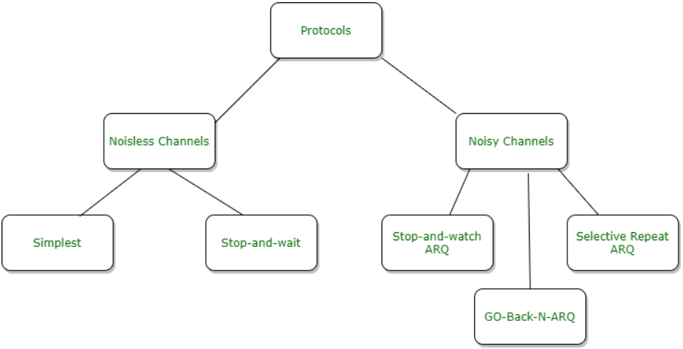
Categorization of protocol :

Slide 5
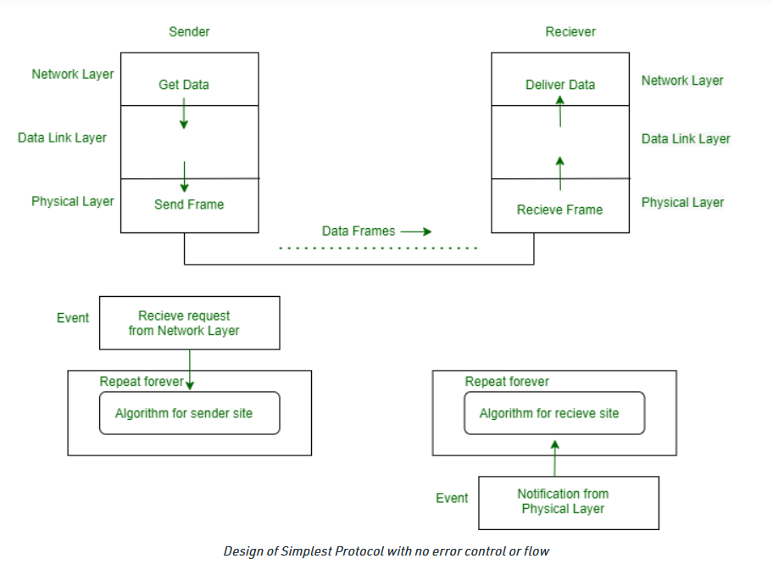
Noiseless Channel :
An idealistic channel in which no frames are lost, corrupted or duplicated. The protocol does not implement error control in this category.
Simplest Protocol –

Slide 6
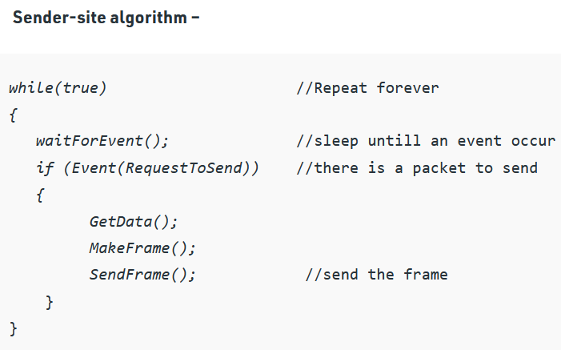
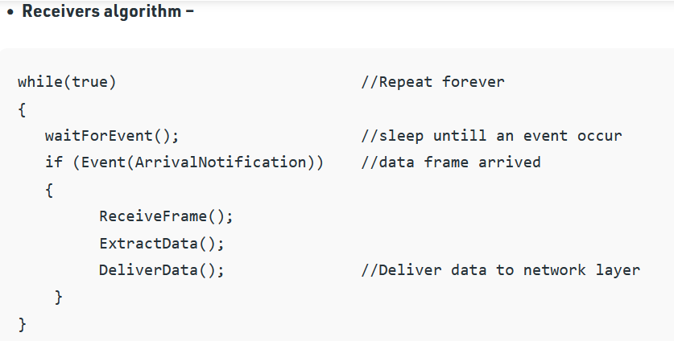
Sender-site and Receivers algorithms:

Slide 7
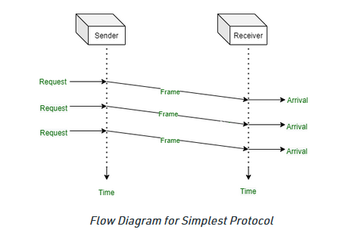
Flow Diagram :

Slide 8
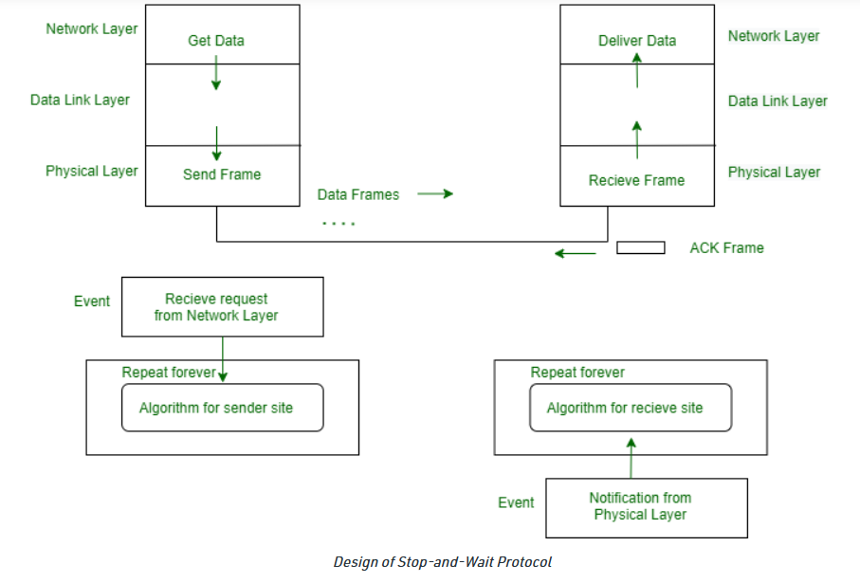
Stop and Wait Protocol –

Slide 9
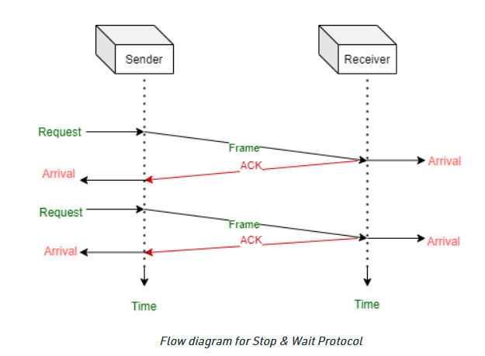
Flow Diagram :

Slide 10
Transport Layer Protocols
Simple Protocol
Stop and Wait Protocol
Go-Back-N Protocol
Selective-Repeat Protocol
﻿Bidirectional Protocols: Piggybacking

Slide 11
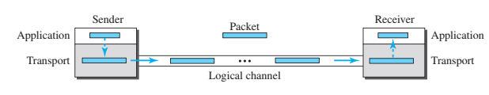
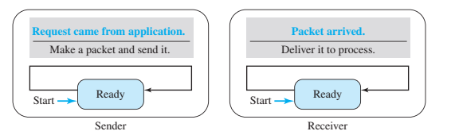
Transport Layer Protocols
Simple Protocol
Figure: Simple Protocol
Figure: FSM for Simple Protocol

Slide 12
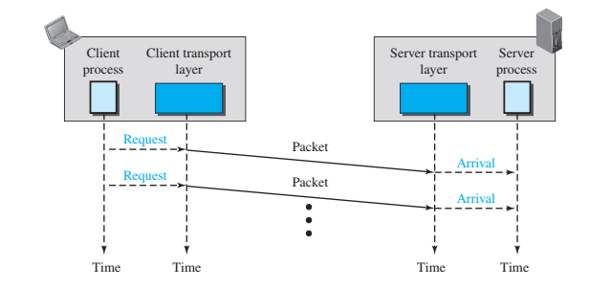
Transport Layer Protocols
1) Simple Protocol
The sender sends packets one after another without even thinking about the receiver

Slide 13
Transport Layer Protocols
2) Stop and Wait Protocol
Uses both flow and error control.
Both the sender and the receiver use a sliding window of size 1.
The sender sends one packet at a time and waits for an acknowledgment before sending the next one.
To detect corrupted packets, a checksum is added to each data packet.
When a packet arrives at the receiver site, it is checked.
If its checksum is incorrect, the packet is corrupted and silently discarded.
﻿The silence of the receiver is a signal for the sender that a packet was either corrupted or lost.

Slide 14
Transport Layer Protocols
2) Stop and Wait Protocol (Cont’d)
Every time the sender sends a packet, it starts a timer.
If an acknowledgment arrives before the timer expires, the timer is stopped and the sender sends the next packet (if it has one to send).
If the timer expires, the sender resends the previous packet, assuming that the packet was either lost or corrupted.
This means that the sender needs to keep a copy of the packet until its acknowledgment arrives.
Only one packet and one acknowledgment can be in the channels at any time.
﻿In the Stop-and-Wait protocol, the acknowledgment number always announces, in modulo-2 arithmetic, the sequence number of the next packet expected.

Slide 15
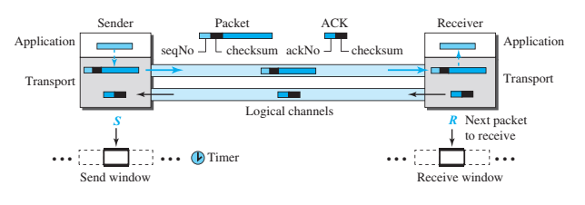
Transport Layer Protocols
2) Stop and Wait Protocol

Slide 16
Transport Layer Protocols
3) Go-back-N Protocol (GBN)
﻿can send several packets before receiving acknowledgments, but the receiver can only buffer one packet
﻿several data packets and acknowledgments can be in the channel at the same time

Slide 17
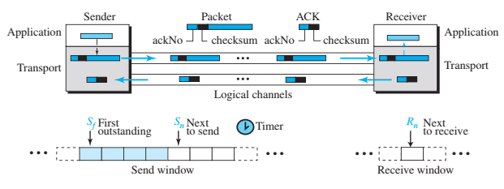
Transport Layer Protocols
3) Go-back-N Protocol (GBN)
﻿﻿In the Go-Back-N protocol, the acknowledgment number is cumulative and ﻿defines the sequence number of the next packet expected to arrive.

Slide 18
Transport Layer Protocols
4) Selective-Repeat Protocol
﻿﻿resends only selective packets, those that are actually lost
﻿An acknowledgment number defines the sequence number of the error-free packet received

Slide 19
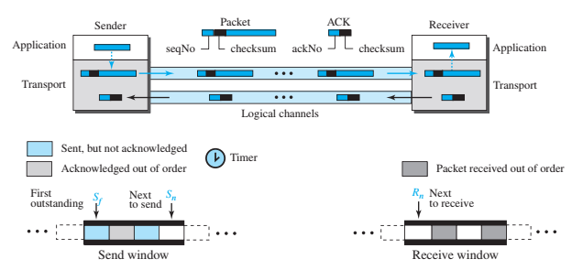
Transport Layer Protocols
4) Selective-Repeat Protocol

Slide 20
Transport Layer Protocols
5) ﻿Bidirectional Protocols: Piggybacking
﻿The four protocols discussed earlier in this section are all unidirectional: data packets flow in only one direction and acknowledgments travel in the other direction.
In real life, data packets are normally flowing in both directions: from client to server and from server to client.
This means that acknowledgments also need to flow in both directions.
A technique, piggybacking, is used to improve the efficiency of the bidirectional protocols.
When a packet is carrying data from A to B, it can also carry acknowledgment feedback about arrived packets from B; when a packet is carrying data from B to A, it can also carry acknowledgment feedback about the arrived packets from A.

Slide 21
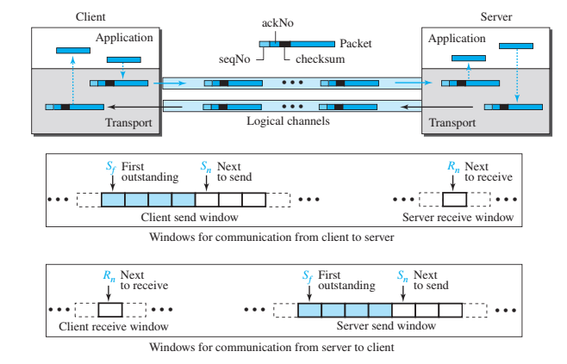
Transport Layer Protocols
5) ﻿Bidirectional Protocols: Piggybacking
﻿The client and server each use two independent windows: send and receive.

Slide 22
Thank you

